Slide 1
Ye Olde Angry Kings
Play
Settings
Quit

Slide 2
Settings
Launcher (drop down)
Ball size(drop down)
**Displays image of launcher**
**Displays size of ball**
Back

Slide 3
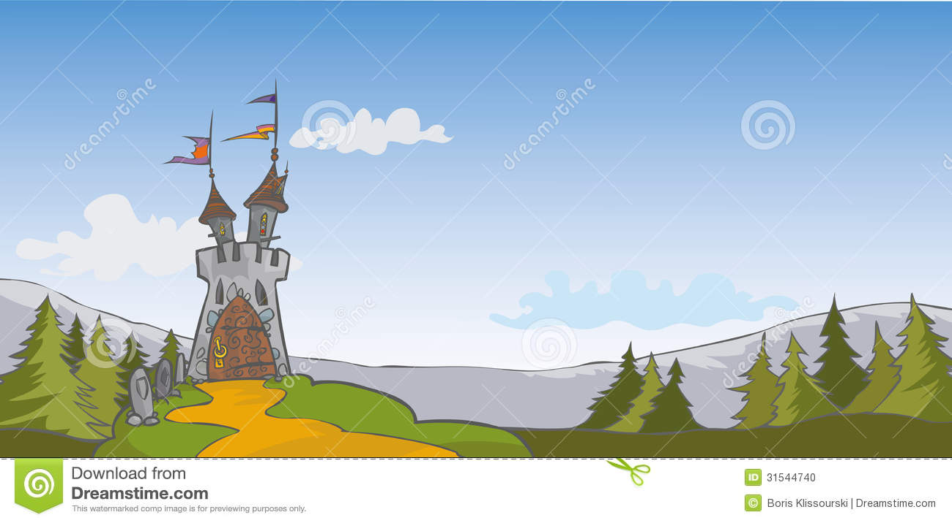
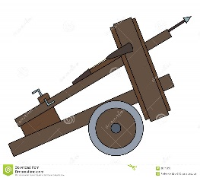
Play Screen
Target
Target
Target
Target
Target
**Angle Selection Box**

Slide 4
Practice Range
Distance Marker
**Angle Selection Box**

Slide 5
References
Ballista:
https://www.dreamstime.com/stock-photos-ballista-cartoon-image28577833
Background:
https://www.dreamstime.com/stock-photo-castle-background-cartoon-illustration-image31544740

